Slide 1
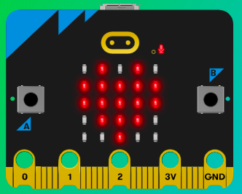
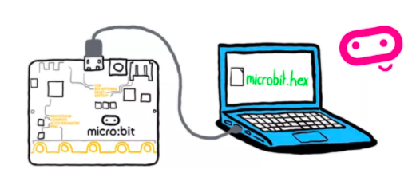
MicroMakers!
KIDS’ MAKER CLUB OF WASHINGTON, DC
Meet Up #16

Slide 2
CIRCUITS!

Slide 3
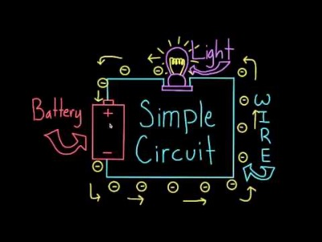
RECAP! What is a Circuit?

Slide 4
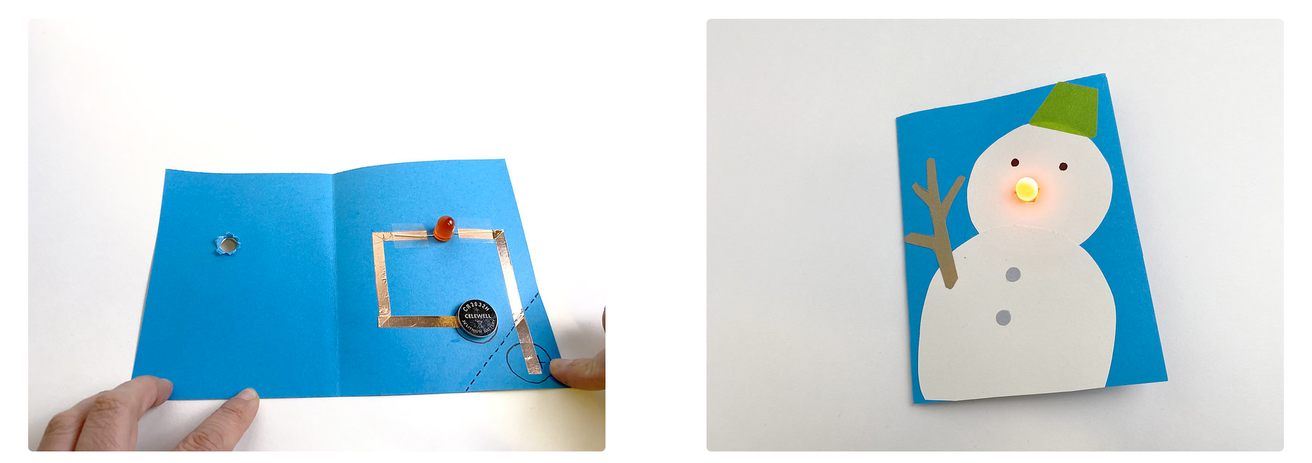
Step 1: The Project Light-Up Card
What is it?
Make a greeting card with a light that turns on when you press a button.
What do I need?
1 working tealight
Small screwdriver
Aluminum foil
Crafty supplies (cardstock, scissors, washi tape, glue sticks, markers, etc.)

Slide 5
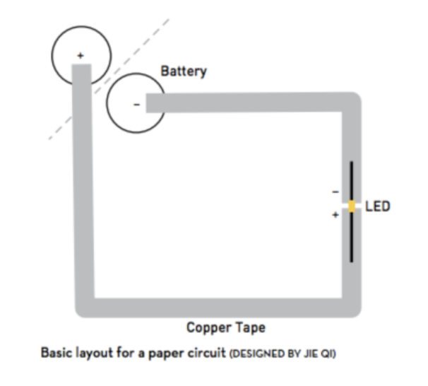
Step 2: How Does it Work?

Slide 6
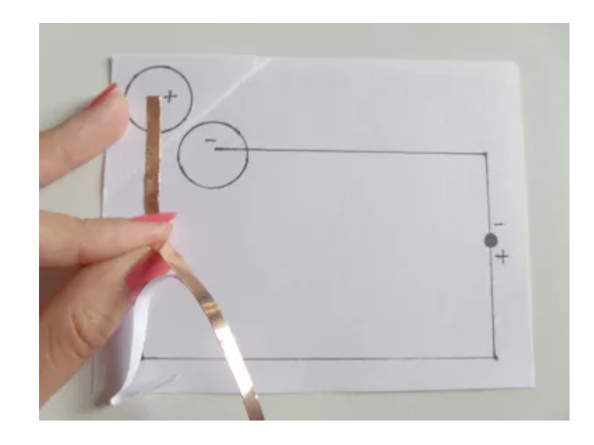
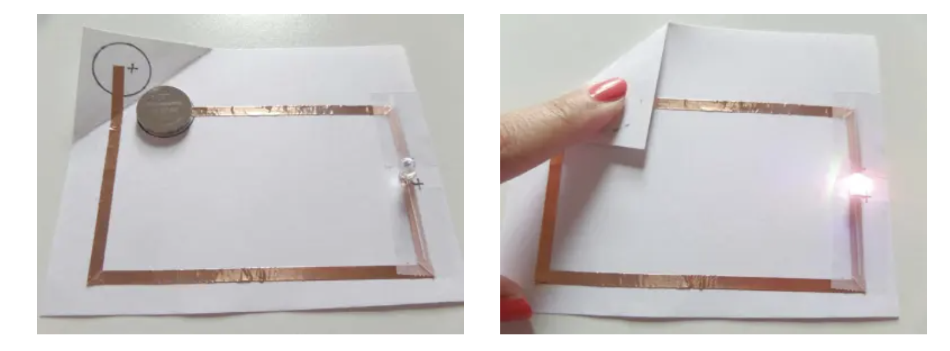
Step 3: Make It (basic circuit)

Slide 7
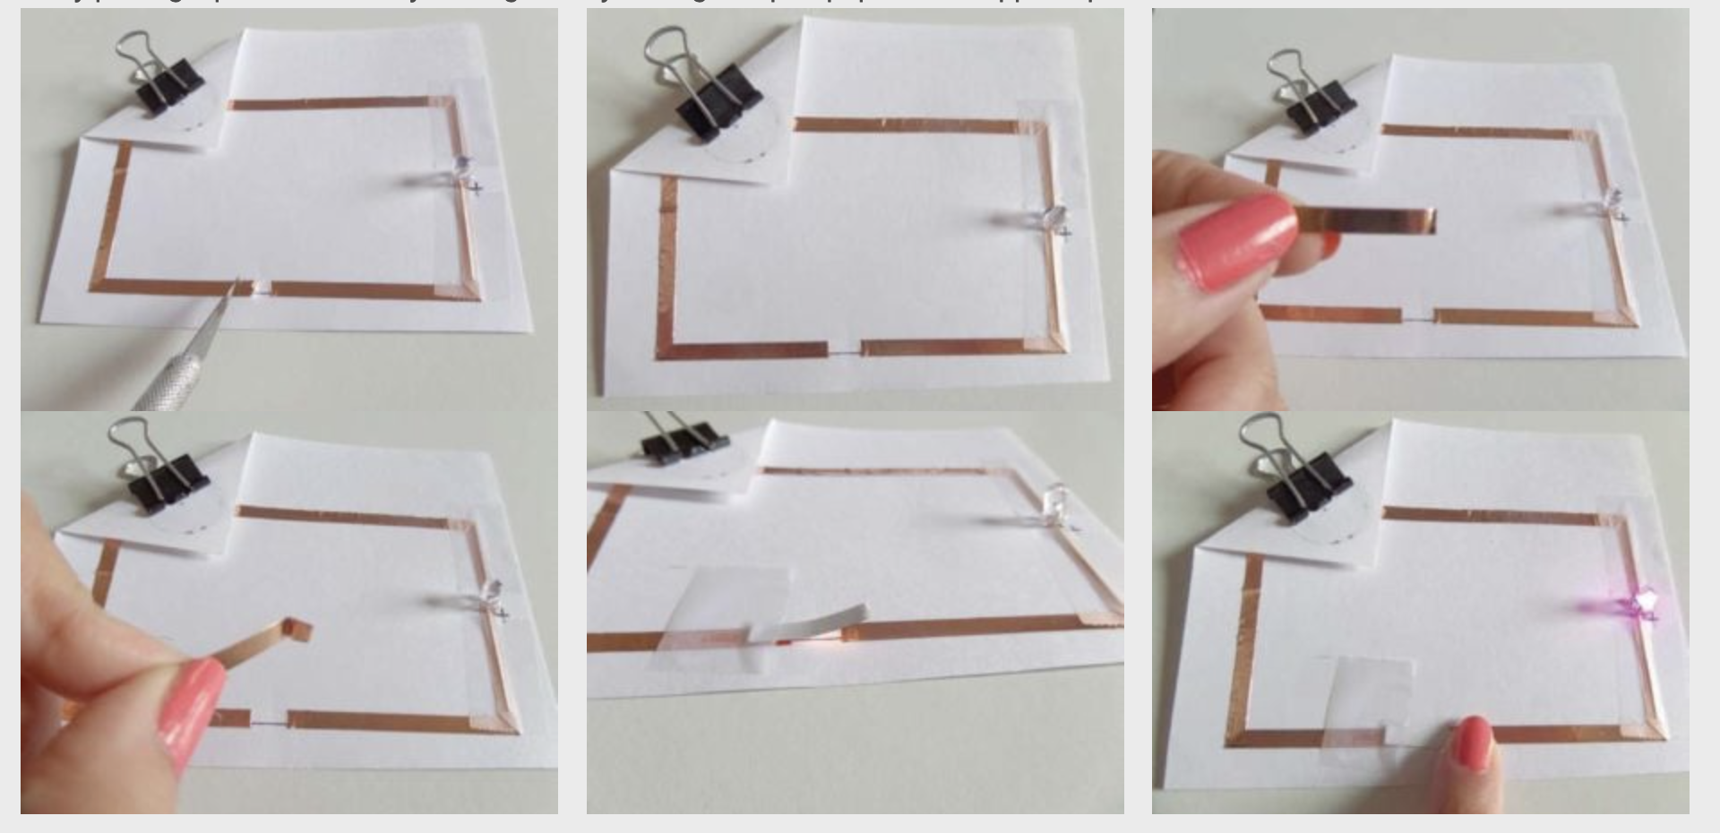
Step 3: Make It (adding a switch)

Slide 8
Step 4: Share Your Creation!

Slide 9
TIME TO PUT AWAY OUR SCRAPPY CIRCUITS!
Neat and tidy, please!
Let’s leave this beautiful room as lovely as we found it!

Slide 10

UNTIL NEXT TIME….
MicroMakers!
Slides and Script: Holly Krambeck (learningpython64@gmail.com)

Slide 11
EXTRA SLIDES

Slide 12
PROGRAMMING PRACTICE!
Expanding Robot Turtles with Loops, Conditions, and Variables

Slide 13
Coding Building Blocks
Practicing Variables, Loops, and Conditions…with Robot Turtles
Variables
Conditions
Loops

Slide 14
Deep Dive into the Code
Practicing Variables, Loops, and Conditions…with Robot Turtles
Variables
Convert “Forward” to a variable, “Forward = X spaces”. Roll the die on each turn to assign random value to “Forward”
Conditions
If Forward <= 3 spaces, add 1 card (any) to your turn. Else, do nothing.
Loops
While no gem is reached, continue playing the game.

Slide 15
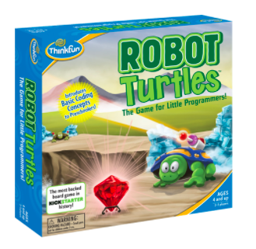
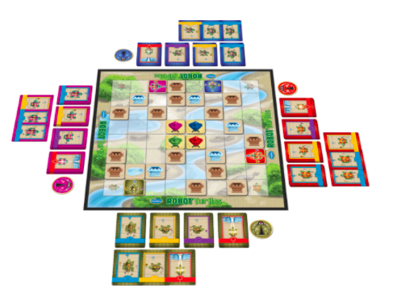
Programming
Let’s Try It!
You tell computers like the micro:bit what to do by giving them instructions. Sets of instructions for computers are called programs. Programs are written in code, a language that both you and the computer can understand.

